Slide 1
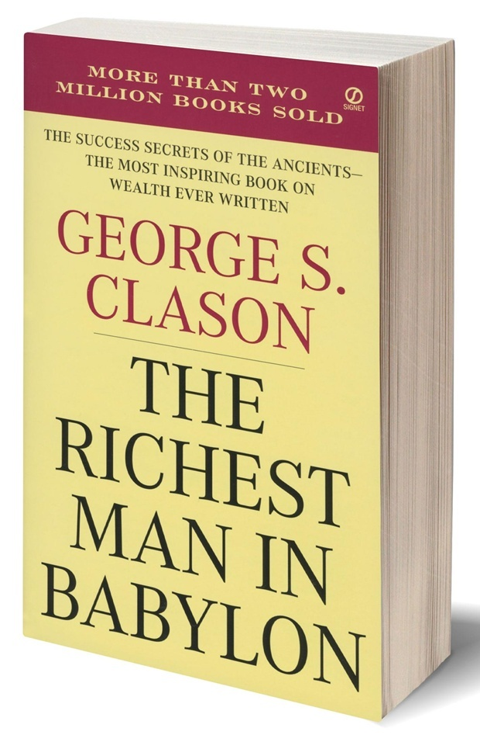
The Richest Man in Babylon

Slide 2
CHAPTER 6:
The Gold Lender of Babylon
“In this chapter we learn a few valuable lessons about lending money.”

Slide 3
About the Story
A young man named Rodan (a Shield Maker) who came into some sudden unexpected money.
It was a reward from the King for his masterful work
The money was significant as it amounted to what he could otherwise save in fifty years.
As you might expect, his “friends” quickly multiplied and his family became bold in their requests for loans.
His sister wanted him to give the money to her husband to start a business venture
Rodan did not want to be be foolish with his money
Rodan wisely seeks the counsel of the gold lender, Mathon, due to his long experience in loaning money successfully.

Slide 4
Valuable Lessons about Lending Money
  Do not lend money unsecured. Require the borrower to provide some sort of collateral
  Do not lend money to someone who cannot repay it to you.
  Do not lend to people who are emotional or make bad choices with money
Collateral
Capacity
  Do not lend to someone who has no stake in the business venture he wants to undertake
  Money should not be sitting idle in your hands, but it should not be invested in high risk ventures
Character
Capital

Slide 5
Other Takeways
Research shows that there is a linear relationship between happiness and money. Happiness increases when you have money
Money needs to be properly manged
Seek wise financial counsel
Do not invest in what you do not understand
Put your money where you are reasonably certain you will get it back, both principal and interest
Do not invest in high risk activities/ventures

Slide 6
Conclusion
“Better a little caution than a great regret.”

Slide 7
thank you

